Slide 1


Performance Analysis of a Solar Thermal Operated Domestic Drying System
Technology Informatics Design Endeavour
Presented by: USN:
PRERAK M SETHIA 1BM15ME117
ROHAN SK 1BM15ME139
SHIKHAR GOYAL 1BM15ME152
SHRAVAN RAJ 1BM15ME155
Under the guidance of:
Praveen T. Hunashikatti
Assistant Professor
BMS College of Engineering, Bangalore

Slide 2
Table of contents
Title | Slide no.
Chapter 1-Introduction 1.1 Drying 1.2 Necessity of Drying 1.3 Drying Kinetics 1.4 Classification of solar dryers 1.5 Direct and Indirect Type Solar Drying | 3 4 4 5 6 7
Chapter 2-Literature Survey | 9
Chapter 3-Cad Model and Specifications | 10
Chapter 4-Methodology 4.1 Objective 4.2 Process Flowchart 4.3 Instruments 4.4 Parameters to be measured | 11 11 12 13 14
Chapter 5- Results and Discussions | 15
Modelling | 20
Conclusion | 28
References | 29
Work flow | 31

Slide 3
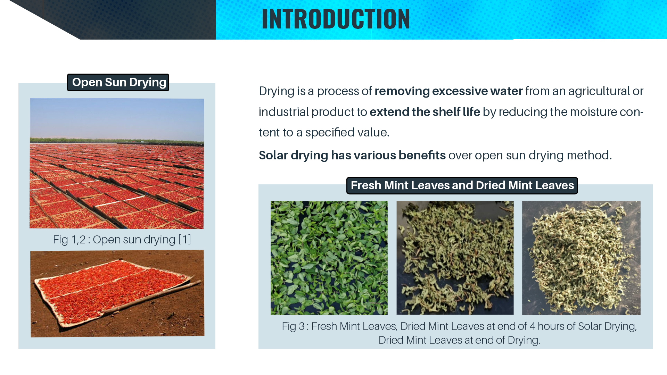

Slide 4
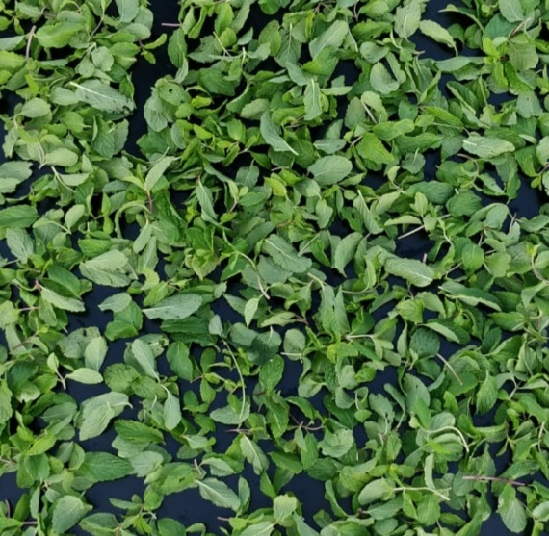
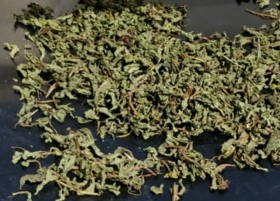
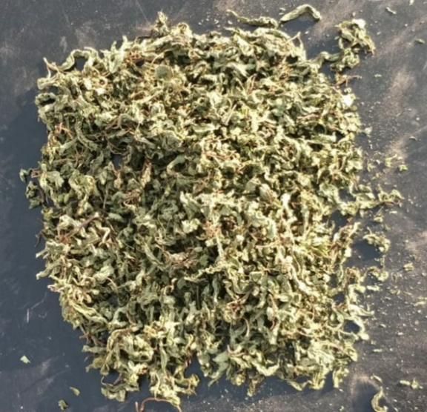
1.1 Solar Drying
Utilisation of solar energy in drying leads to fast rate of drying and exposure of products against rain, dust, storm, birds, rodents, insects and pests are avoided.
1.2 Necessity of Drying
Drying of food products is aimed at longer storage periods, lower packaging requirements and shipping weights, avoids degradation of products and can also be used as skin care products.
Fig 4. Fresh Mint Leaves, Dried Mint Leaves at end of 4 hours of Solar Drying, Dried Mint Leaves at end of Drying.

Slide 5
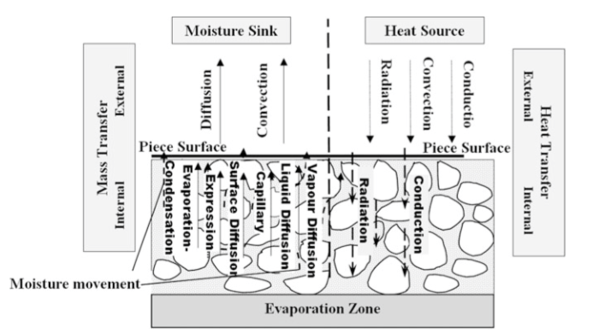
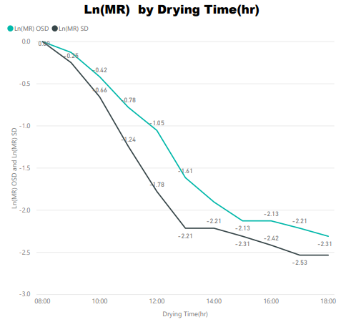
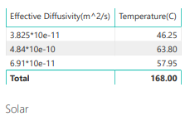
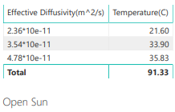
1.3 Drying kinetics
1.3.1 Mechanism of Drying.
Energy Transfer can take place through convection, conduction, Radiation or external heating.
Moisture removal takes place by Diffusion and convection.
Fig 5. Drying mechanism[4]
Ln(MR) = ln(8/π²) – (πD_{eff}/4L²)t (1) [7], Where D_{eff} is the effective diffusivity coefficient.
Fig 6. Effective Moisture Diffusivity

Slide 6
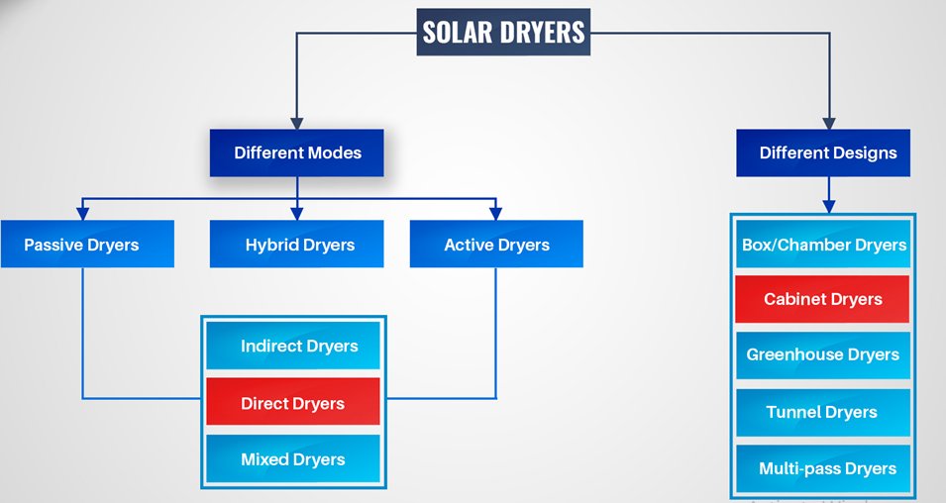
1.4 Classification of solar dryers
Fig 7. Classification of Solar Dryers

Slide 7
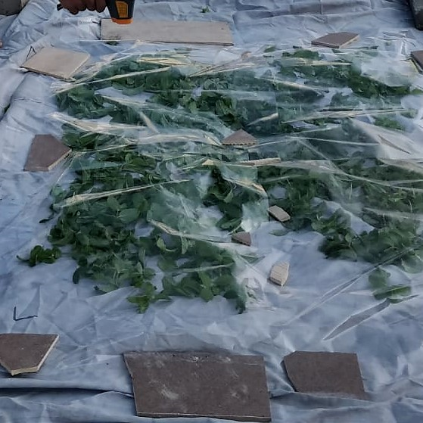
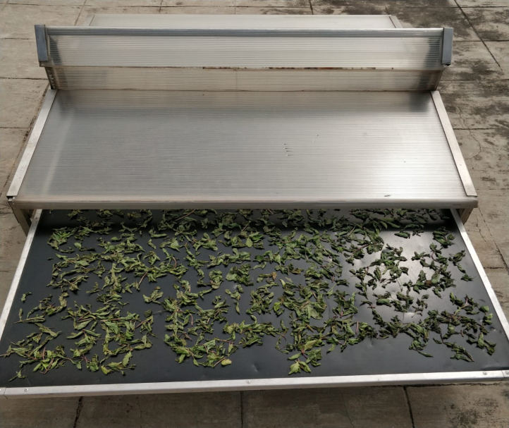
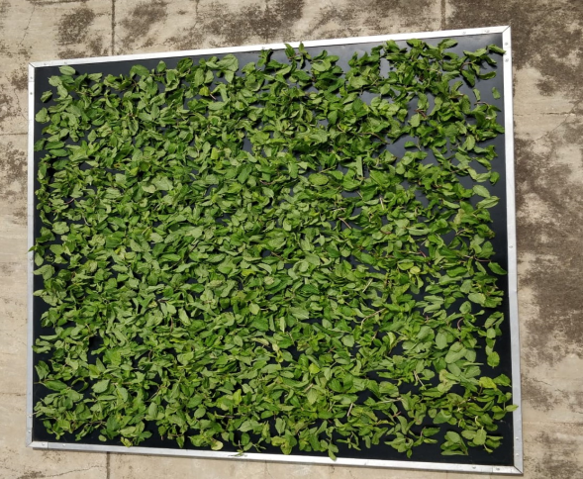
1.5 Open Sun and Solar Drying
Fig 8. Open Sun Drying
Fig 9. Solar Drying

Slide 8
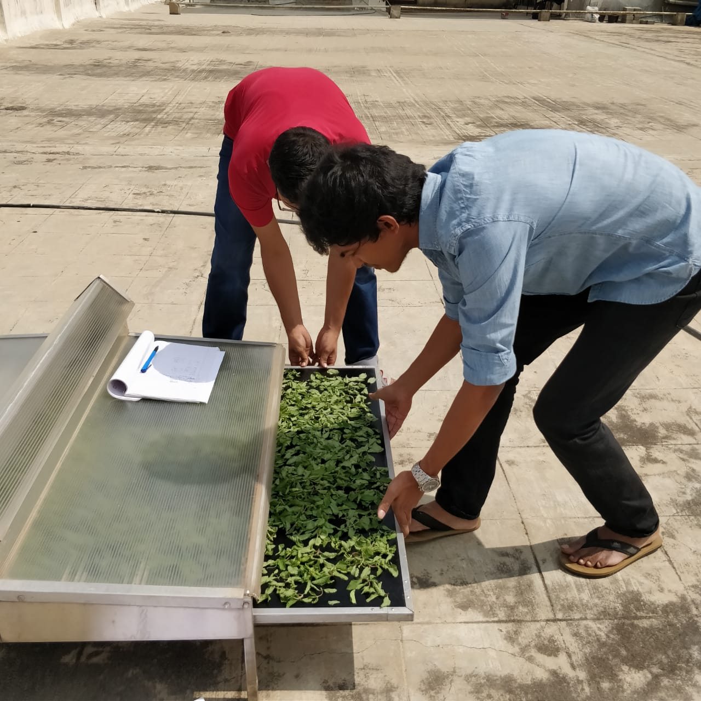
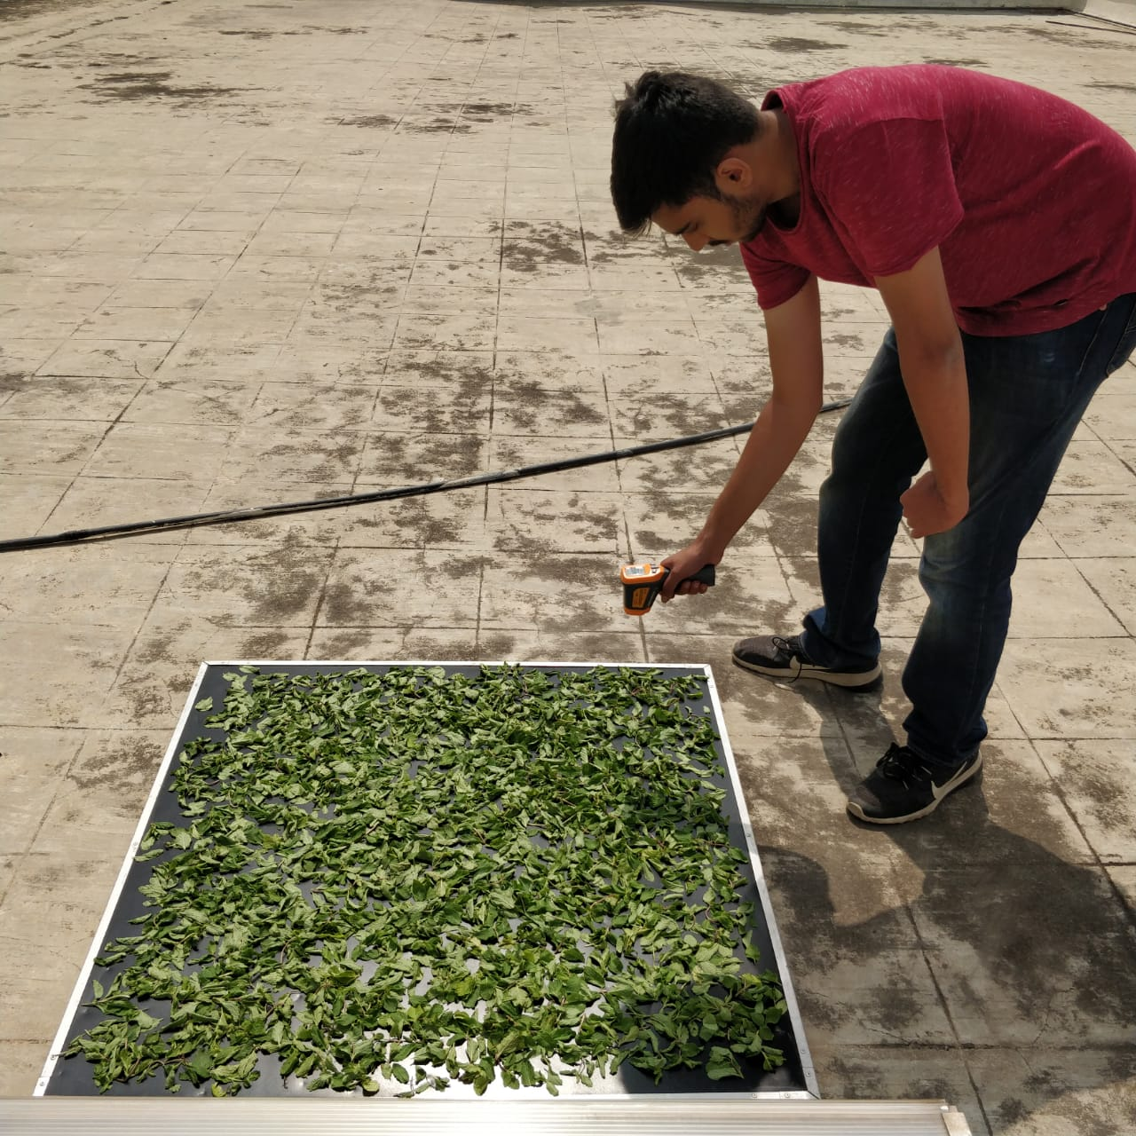
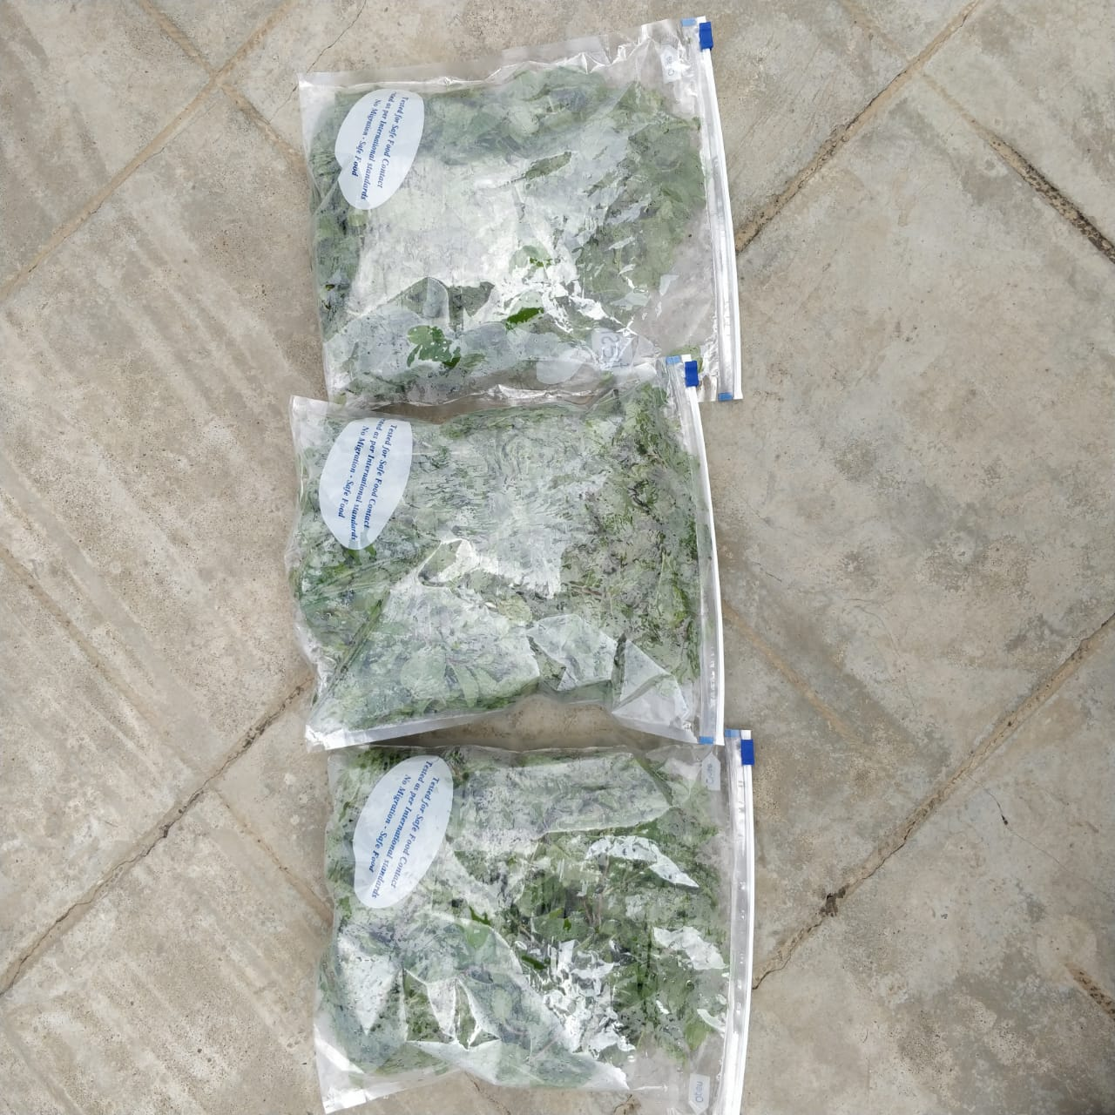
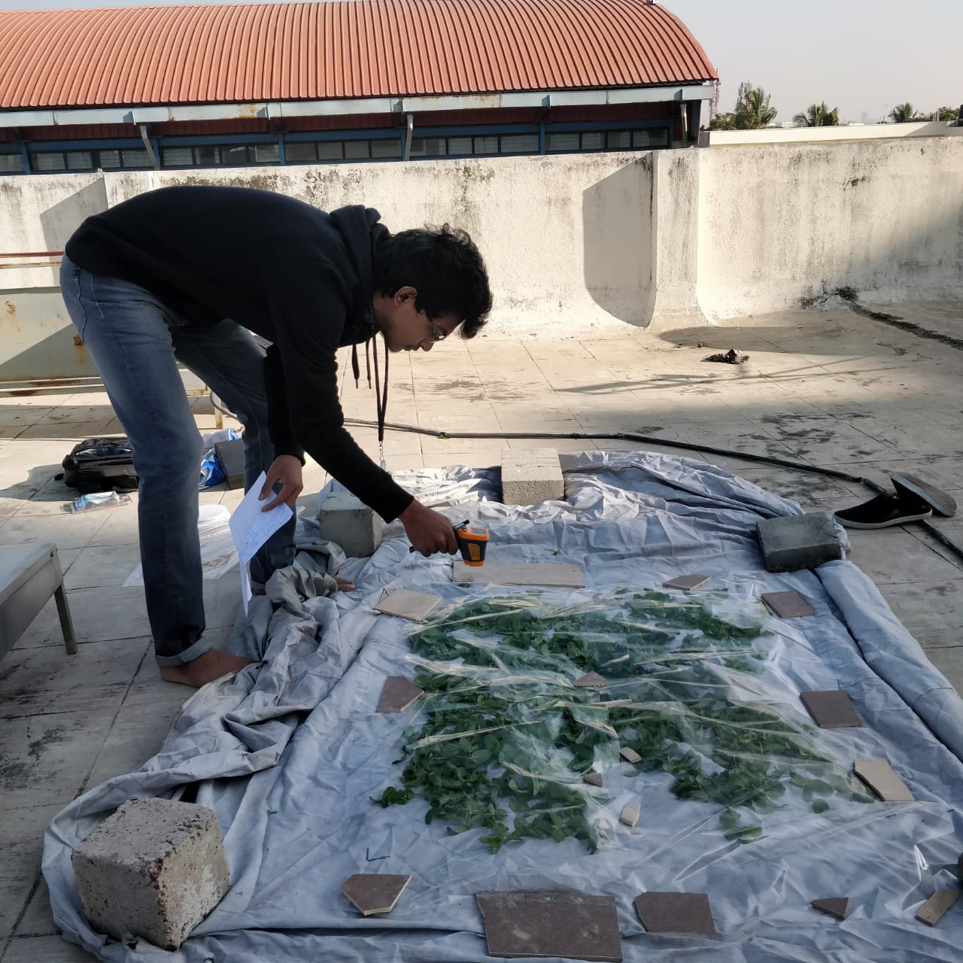
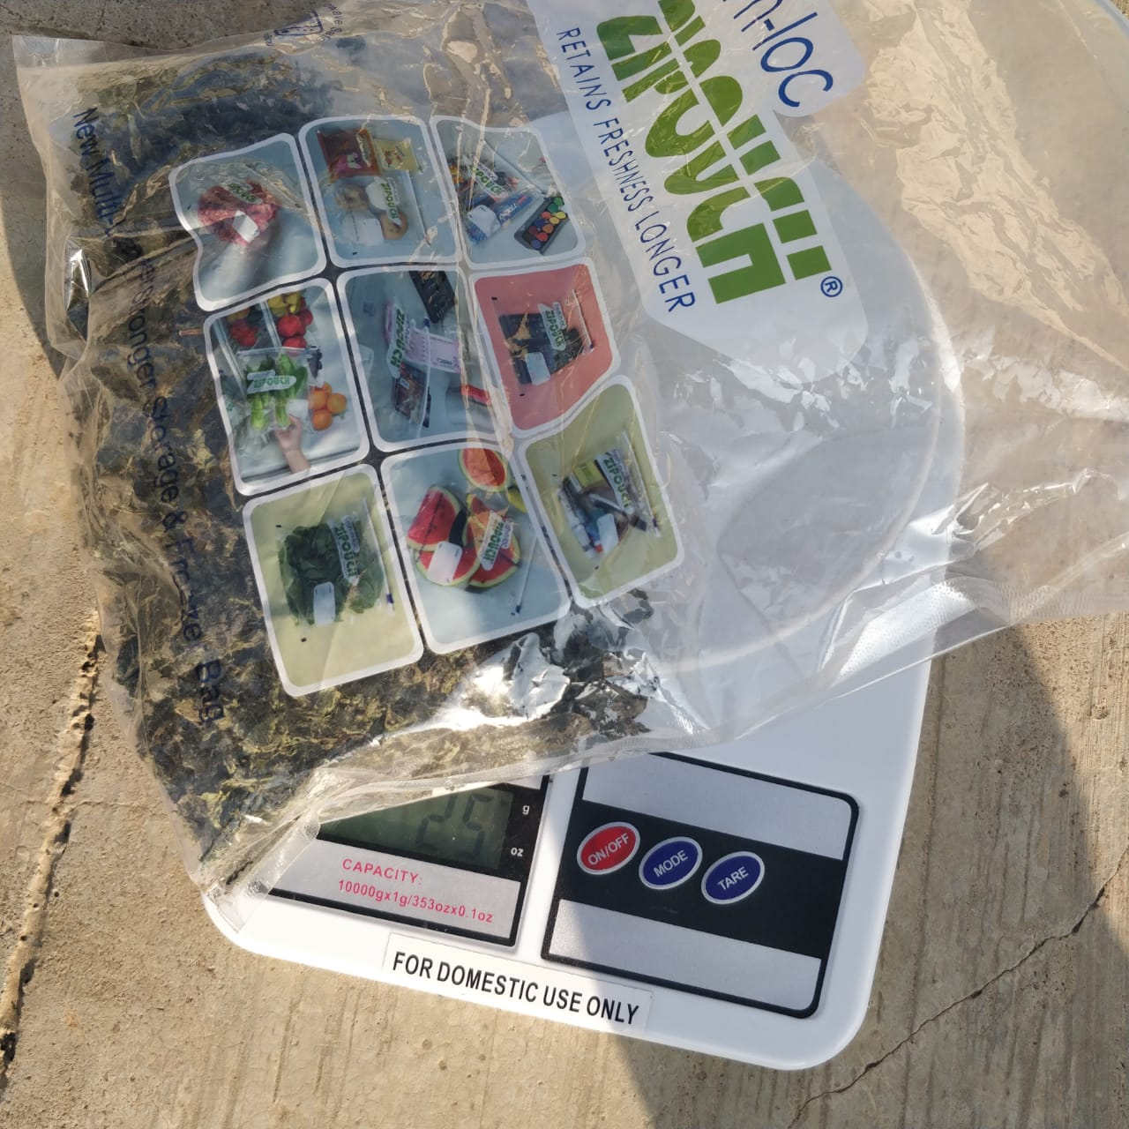
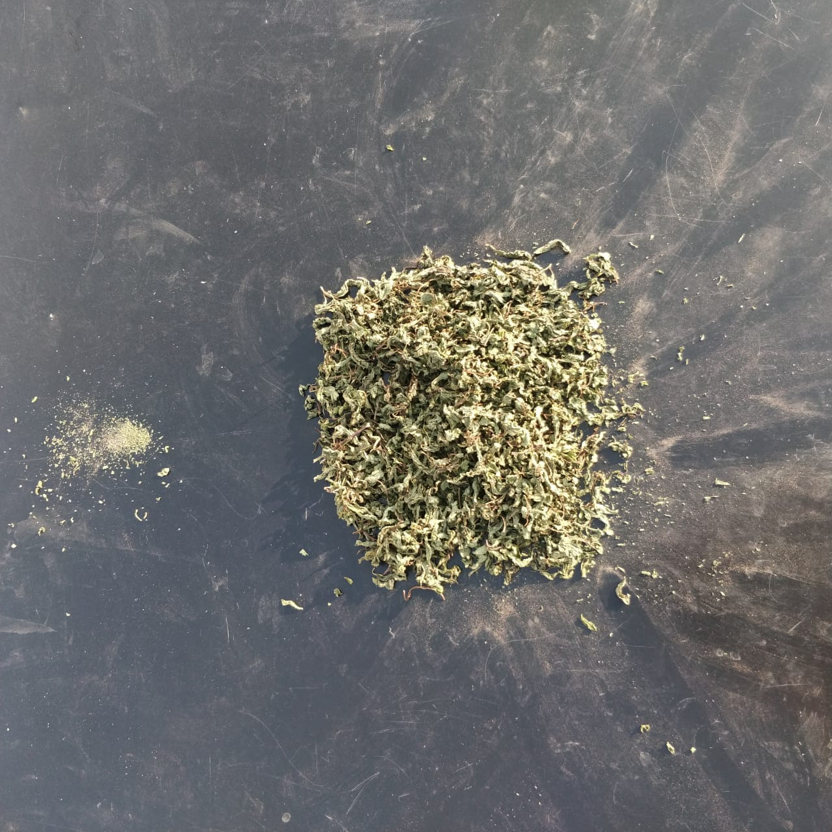
Conduction of Experiment

Slide 9
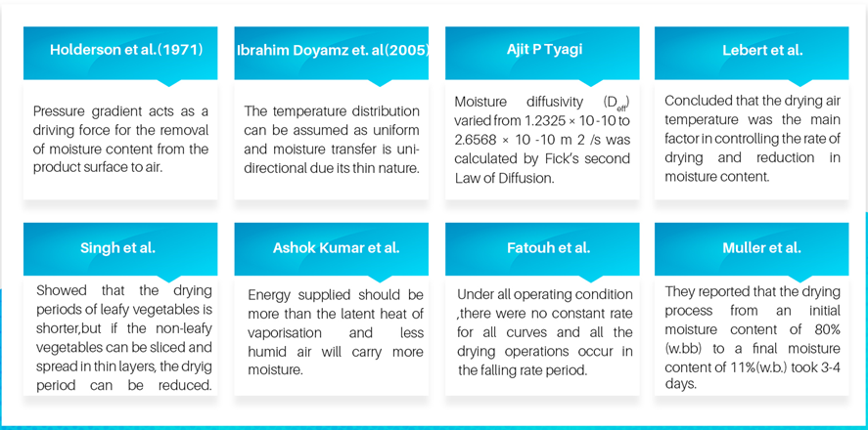
2. Literature Survey

Slide 10
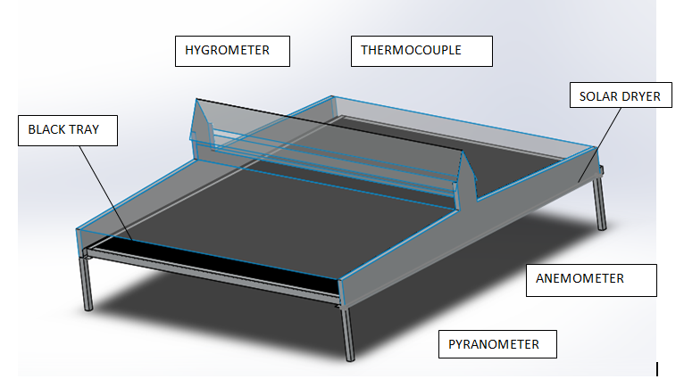
3. Cad Model
Table.No.1 Specifications of the coupled system
Solar dryer
Material | Aluminium frame
Inner tray area | 1m²
High side and low side | 0.502m and 0.184m
Glass cover
Thickness | 0.005m
Inclination | 2.13⸰

Slide 11
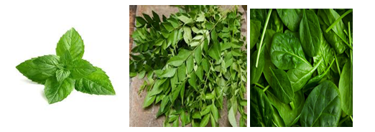
4. Methodology
4.1 Objective
The experiments were conducted to study the thin layer drying behaviour of mint leaves, Spinach Leaves and curry leaves using Solar dryer.
Herbs were procured from local market and cleaned by removing undesired stems and waste materials.
A sample size of 300g was be used for the study.
Fig 10 Mint Leaves, Curry Leaves, Spinach leaves [9]

Slide 12
Harvesting
Stem Removal, Cleaning and Washing
Weighing
(300g)
Open sun and Solar Drying Process
Tabulation of required parameters
4.2 Process Flowchart
Performance Analysis
Plotting of Drying Curves
Curve fitting to get the best mathematical model
Comparison of drying behaviour of open sun and Solar drying
Storage of Herbs

Slide 13
4.3 Instruments used
Table.No.2 Instruments List
S.NO. | Instruments | Model no. | Specifications
1. | Hygrometer | STC 2 | Accuracy +/- 5%
2. | Anemometer | HTC AVM-07 | Least count- 0.1 m/s
3. | IR Thermometer | AP-IS11A001 | Temperature measurement accuracy:±1°C
4. | Weighing balance | SF 400 | Least count- 1 g Maximum weight- 10 kg

Slide 14
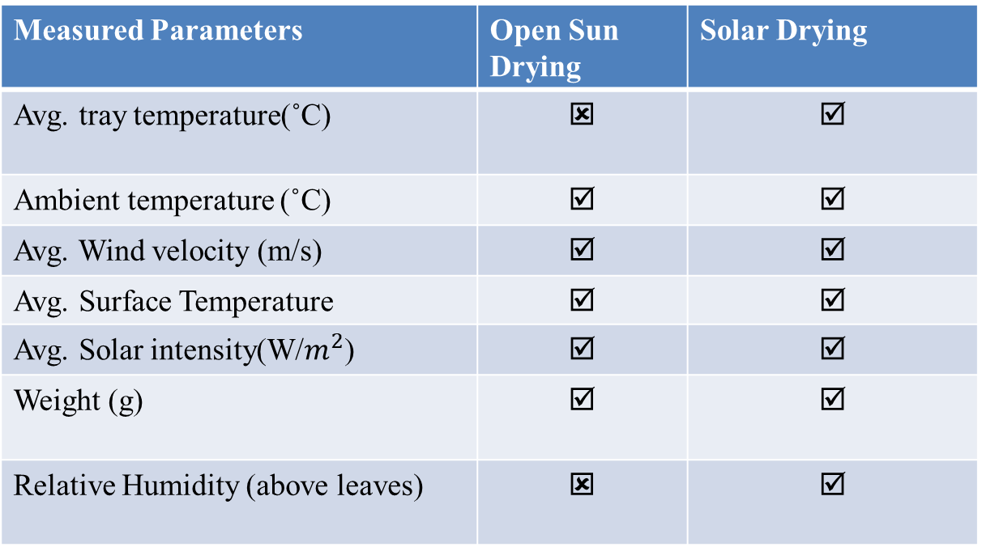
4.4 Parameters to be Measured
Table.No.3. Measured Parameters for Open Sun Drying and Solar Drying
Measured Parameters | Open Sun Drying | Solar Drying
Avg. tray temperature(˚C) | ☒ | ☑
Ambient temperature (˚C) | ☑ | ☑
Avg. Wind velocity (m/s) | ☑ | ☑
Avg. Surface Temperature | ☑ | ☑
Avg. Solar intensity(W/$m^{2}$) | ☑ | ☑
Weight (g) | ☑ | ☑
Relative Humidity (above leaves) | ☒ | ☑

Slide 15
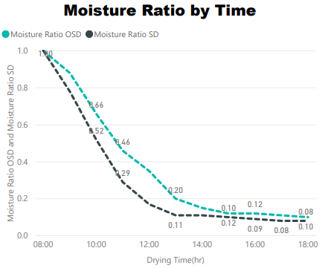
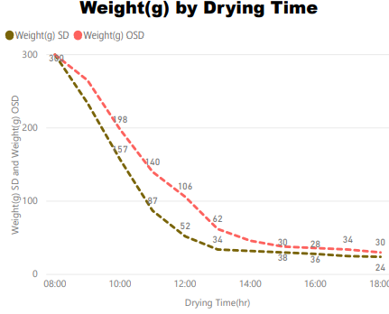
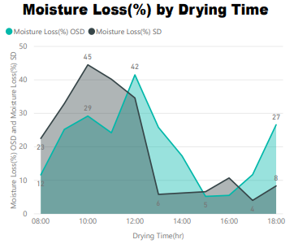
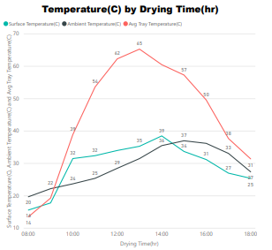
5. Results and Discussions
Fig 11. Drying Curves for Mint Leaves(04/02/19)

Slide 16
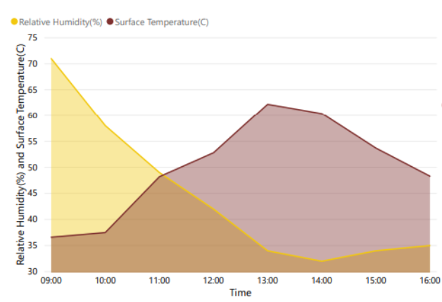
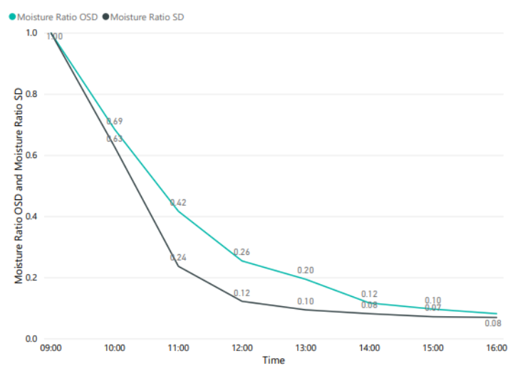
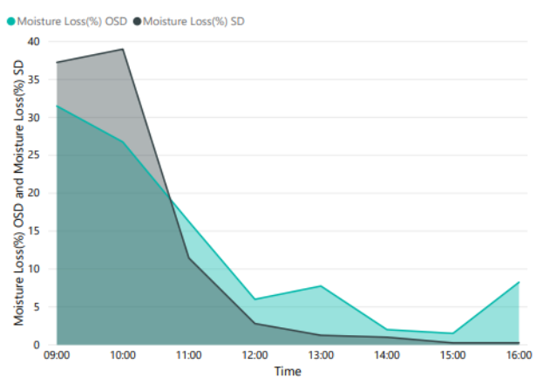
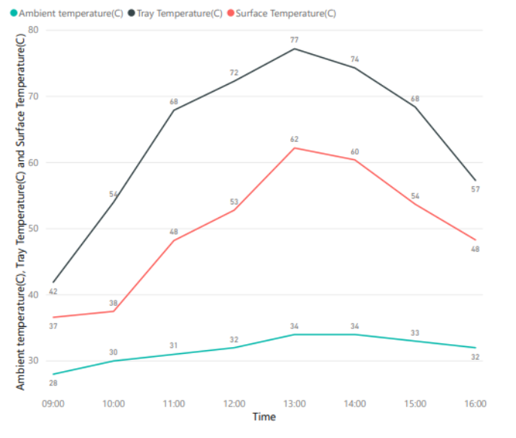
Moisture ratio v/s time
Relative humidity v/s time
Moisture loss v/s time
Temperature v/s time
Fig 12. Drying Curves for spinach leaves(27/04/19)

Slide 17
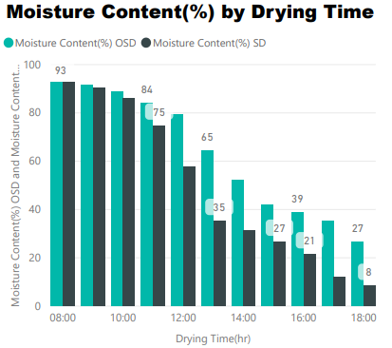
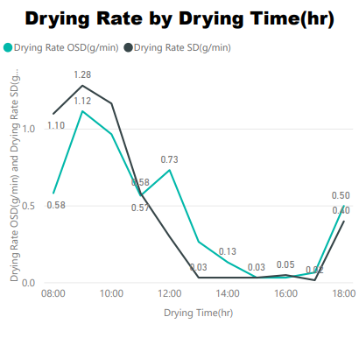
5.1 Moisture Content(%) and Drying Rate
MINT
LEAVES
MINT
LEAVES
Fig 13. Moisture Content and Drying Rate for Mint Leaves
It is Evident from the Graph that Reduction in Moisture Content In Solar Drying is Much Faster than that of Open sun drying, It took 7 Hours for 66% Moisture loss in Solar Drying where as it took 10 Hours in Open Sun Drying.
Total Average Moisture Reduction in Solar Drying was from 92.6% to 8.33% in time Span of 10 Hours.
Drying Rate for Solar Drying is more as compared to Open Sun.

Slide 18
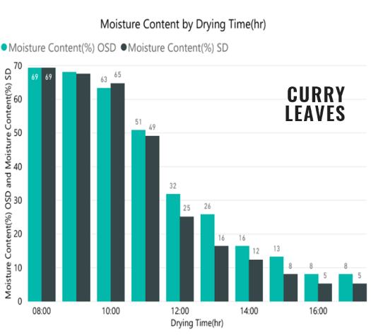
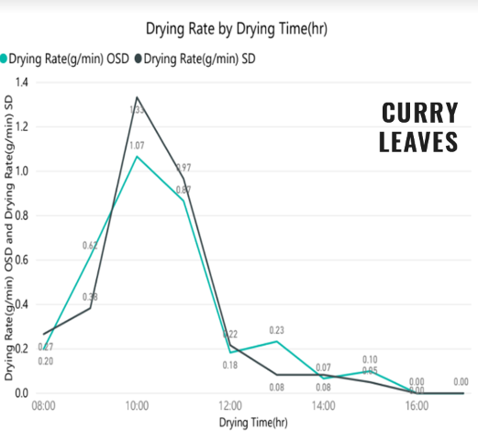
Fig 14. Moisture Content and Drying Rate for Curry Leaves
Four Hours for 63.8% Moisture Removal in Solar Drying.
Five Hours for the same Moisture removal in Open sun drying.
Higher Temperature attained and greater Drying Rate is achieved in Solar Dryer.

Slide 19
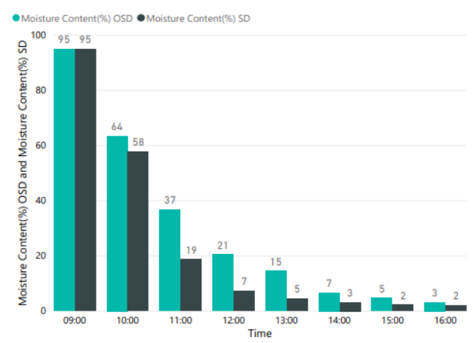
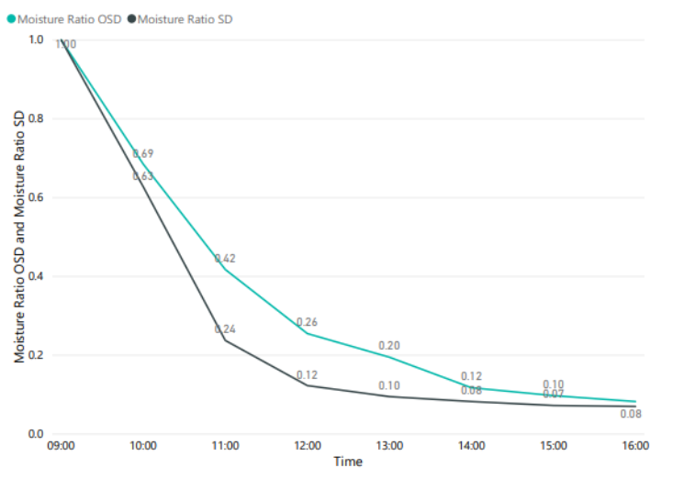
SPINACH LEAVES
SPINACH LEAVES
Fig 15. Moisture Content and Drying Rate for Spinach Leaves
Reduction in Moisture Content In Solar Drying is Faster than that of Open sun drying by about 2 hours.
Total Average Moisture Reduction in Solar Drying was from 95% to2% in time Span of 7 Hours.
Drying Rate for Solar Drying is more as compared to Open Sun.

Slide 20
6. Modelling
Modelling of Data was done in Power Bi 2016 to develop Accurate Data Model for Visualisation and Comparision of Open sun and Solar Drying.
Curve Fitting Tool Box in Matlab was used for mathematical Modelling.
Purpose: Mathematical models were chosen during Literature survey and Polyfit function of Matlab was used for Curve fitting hence the best Model was chosen based on RMSE and R².
Table.No.4 Mathematical Modeling
MODEL NUMBER | MODEL NAME | MODEL EQUATION | REFERENCES
1 | Lewis/Newton | MR = expt(-kt) | Ayensv(1997), Ozden and Denves (1999)
2 | Henderson and Pabis | MR= aexpt(-kt) | Kabganian
3 | Logarithmic | MR = aexpt(-kt+c) | E Kavak Akpinar ( 2003 )
4 | Page | MR=expt(-kt^{n}) | Diamante and Munro ( 1993 )
5 | Wang and Singh | MR= 1+ at+bt² | Midilli A, Kucuk H

Slide 21
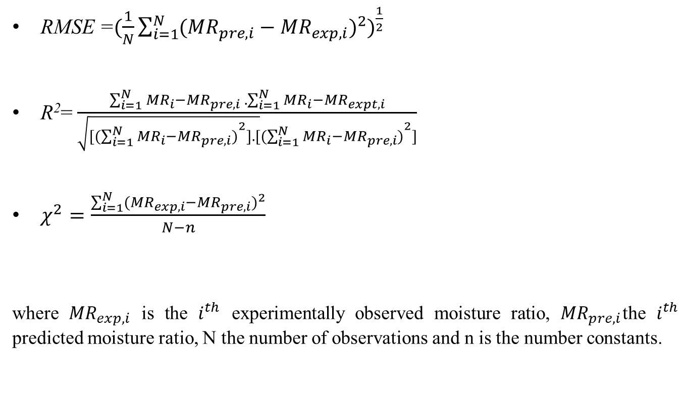
6.1 Parameters to decide best fitting curve
RMSE =$(\frac{1}{N}\sum_{i=1}^{N}{({{{MR}_{pre,i}−{MR}_{exp,i})}^{2})}^{\frac{1}{2}}}$
R²= $\frac{\sum_{i=1}^{N}{{MR}_{i}−{MR}_{pre,i} . \sum_{i=1}^{N}{{MR}_{i}−{MR}_{expt,i}}}}{\sqrt{{[(\sum_{i=1}^{N}{{MR}_{i}−{MR}_{pre,i})}}^{2}].[}{(\sum_{i=1}^{N}{{MR}_{i}−{MR}_{pre,i})}}^{2}]}$
$χ^{2}=\frac{\sum_{i=1}^{N}{{({MR}_{exp,i}−{MR}_{pre,i})}^{2}}}{N−n}$
where ${MR}_{exp,i}$ is the $i^{th}$ experimentally observed moisture ratio, ${MR}_{pre,i}$the $i^{th}$ predicted moisture ratio, N the number of observations and n is the number constants.
(2) [7]
(3) [7]
(4) [7]

Slide 22
Table.No.5 Modelling Results for Solar Drying
SOLAR DRYING
MODEL NUMBER | MODEL NAME | EXPECTED RESULTS |  |  |  | ACTUAL RESULTS
 |  | MODEL CONSTANTS | R | χ2 | RMSE | MODEL CONSTANTS | R | χ2 | RMSE
1 | Lewis/Newton | k=0.000175 | 0.97917 | 0.00532338 | 0.06824925 | k =0.000148 | 0.987 | 0.00163 | 0.0496
2 | Henderson and Pabis | a=1.072410, k= 0.000192 | 0.98143 | 0.00554117 | 0.06446611 | a = 1.025; k = 0.3938 | 0.988 | 0.001435 | 0.0514
3 | Logarithmic | a=1.206919,k=0.000149, | 0.99191 | 0.002912 | 0.04266144 | a = 0.9925; k = 0.4952; c = 0.05016 | 0.9914 | 0.074961 | 0.0463
4 | Page | K=0.000261, n=0.950314 | 0.97423 | 0.00766217 | 0.07580652 | k=0.3675 n=1.01 | 0.9878 | 0.002498 | 0.0519
5 | Wang and Singh | a=0.000121063342999; | 0.99918 | 0.00024726 | 0.01361781 | a = -0.2708; b = 0.0187; | 0.97954 | 0.000355 | 0.0672
MODEL NUMBER | MODEL NAME | ACTUAL RESULTS
 |  | MODEL CONSTANTS | R | χ2 | RMSE
1 | Lewis/Newton | k = 0.000148 | 0.987 | 0.00163 | 0.0496
2 | Henderson and Pabis | a = 1.025; k = 0.3938 | 0.988 | 0.001435 | 0.0514
3 | Logarithmic | a = 0.9925; k = 0.4952; c = 0.05016 | 0.9914 | 0.074961 | 0.0463
4 | Page | k=0.3675 n=1.01 | 0.9878 | 0.002498 | 0.0519
5 | Wang and Singh | a = -0.2708; b = 0.0187; | 0.97954 | 0.000355 | 0.0672

Slide 23
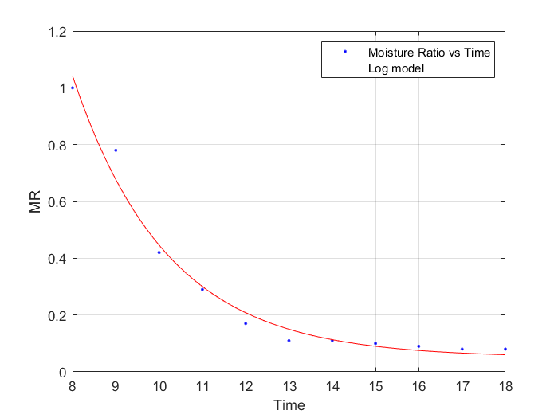
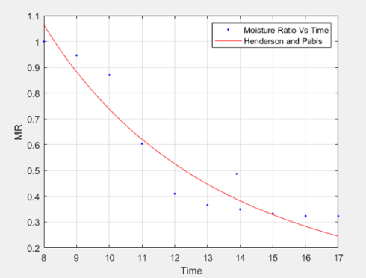
The least RMSE and highest R values were obtained from the logarithmic model for Mint Leaves and Henderson and Pabis model for Solar Drying of Curry Leaves.
Fig 16. Model Curve Fitting

Slide 24
Table.No.6 Modelling Constants for Open Sun Drying
OPEN SUN DRYING
MODEL NUMBER | MODEL NAME | EXPECTED RESULTS |  |  |  | ACTUAL RESULTS
 |  | MODEL CONSTANTS | R | χ2 | RMSE | MODEL CONSTANTS | R | χ2 | RMSE
1 | Lewis/Newton | k = 0.000148 | 0.99231 | 0.00162958 | 0.03889957 | k = 0.2627 | 0.987 | 0.00163 | 0.0525
2 | Henderson and Pabis | a = 1.082567; k = 0.000178 | 0.99375 | 0.00143516 | 0.03507333 | a = 0.99; k = 0.2793 | 0.99375 | 0.001435 | 0.049
3 | Logarithmic | a = 0.774760; k = 0.100000; c = 0.225240 | 0.63508 | 0.07496144 | 0.24268967 | a = 1.073; k = 0.2712; c = -0.01247 | 0.95289 | 0.074961 | 0.0518
4 | Page | k=0.000308; | 0.9891 | 0.00249779 | 0.04627057 | k=0.1885; | 0.986 | 0.002498 | 0.0566
 |  | n=0.927493 |  |  |  | n=1.246
5 | Wang and Singh | a = 0.000107629056564; b = 0.0000000028965 | 0.99883 | 0.00035506 | 0.01744519 | a = -0.2127; b = 0.01242 | 0.9652 | 0.000355 | 0.091

Slide 25
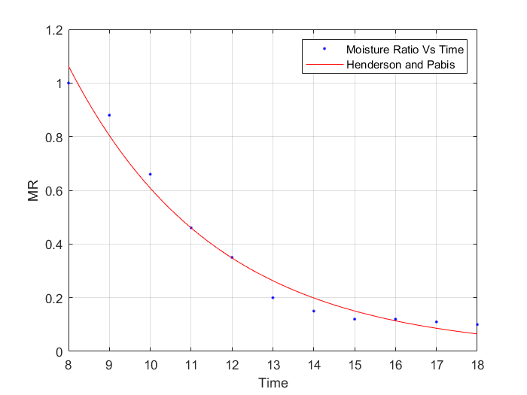
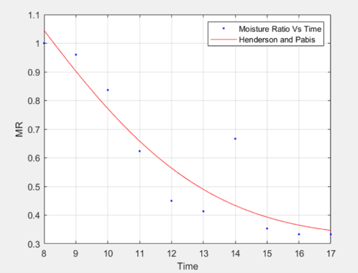
The least RMSE and highest R values were obtained from Henderson and Pabis model for Open Sun Drying of both Mint and Curry Leaves.
Fig 17. Curve Fitting Model

Slide 26
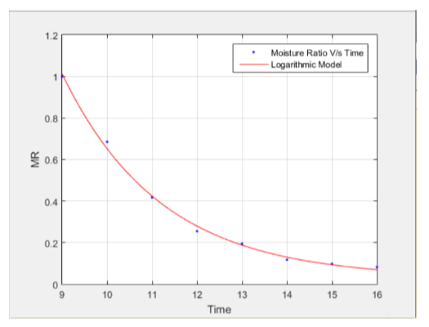
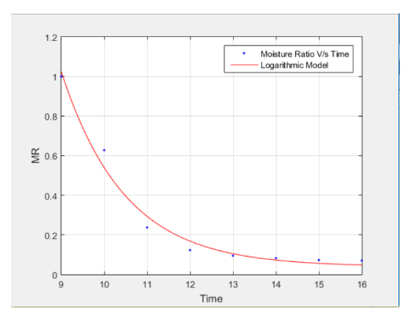
Modelling results for spinach leaves
Logarithmic model was found to be the best fitting model for both open sun and solar drying of spinach leaves.
Fig 18. Logarithmic model for open sun drying
Fig 19. Logarithmic model for solar drying
RMSE = 0.0212
RMSE = 0.0538

Slide 27
Validation Of Results
These models are evaluated based on R, χ² and RMSE. Logarithmic Model was found to be the best descriptive model for the thin layer forced solar drying and natural sun drying of mint leaves. From Logarithmic model for the thin layer forced solar drying of mint leaves, we can expect that RMSE = 0.0463, χ2 = 0.001435 ,R=0.9914.
For the thin layer natural sun drying of mint leaves, Henderson and Pabis model gave as RMSE = 0.049, R=0.99375, χ2 = 0.001435
Validation of the established model was made by comparing the computed moisture contents with the measured moisture contents in any particular drying run under certain conditions.

Slide 28
Conclusion
In order to explain the drying behaviour and to develop the mathematical modelling of mint leaves, five models in the literature were applied to thin layer forced solar drying and open sun drying processes.
One of the most important aspect of drying technology is the mathematical modelling of the drying process and equipment . Its purpose is to allow design engineers to choose the mot suitable operating conditions and then size the drying equipment and dying cabinet accordingly and meet the desired operating conditions .
The results showed that the logarithmic model for mint leaves under solar drying describes best drying behaviour.
Henderson and Pabis for curry most suitably describes drying curve of the thin layer solar drying process and Henderson and Pabis model is best suited for open sun drying of mint and curry leaves.
Logarithmic model for Spinach most suitably describes drying curve of the thin layer solar and open sun drying process.

Slide 29
References
1. Akpinar E. K, Drying of mint leaves in a solar dryer and under open sun: Modelling, performance analyses, Energy Conversion and Management, 51 (12), pp. 2407–2418, 2010.
2. Drying of leaves and herbs- https://goo.gl/fjyPNb (Image)
3. Om Prakash, Anil Kumar, Review on Indian Solar Drying Status, Energy Conversion and Management, 20 October 2016
4. Fresh mint isolated on white background, Image ID:27836716, Copyright: Alfio Scisetti. (Image)
5. A. Saleh , Modelling and Experimental studies on a Domestic Solar Dryer Renewable Energy, Energy Conversion and Management,34(10):2239-2245, October 2009
6. Solar Energy Centre, Ministry of New and Renewable Energy, Govt. of India http://mnre.gov.in/sec/DNI_Annual.jpg ,11thdec, 2018.
7. Ibrahim Doymaz, Thin-layer drying behaviour of mint leaves, Journal of Food Engineering, 74(3), pp.370–375.

Slide 30
8. S. R. Navale , V. M. Harpaleb, K. C. Mohite , Comparative study of open sun and cabinet solar drying for fenugreek leaves, International Journal of Renewable Energy Technology Research, 4(2), pp.1-9, 2015.
9. Ajit P. Tyagi, Solar radiant energy over India, Ministry of New and Renewable Energy and India Meteorological Department, Ministry of Earth Sciences, New Delhi, pp.24-29, 2009.
10. Wankhade PK, Sapkal RS, Sapkal VS , Design and performance evaluation of solar dryer, IOSR Journal of Mechanical and Civil Engineering (IOSR-JMCE), 3(2), pp.70-73, 2014.
11. Holdsworth SD ,Dehydration of food products a review, International Journal of Food Sciences, pp.366-384, 1971.

Slide 31
Work Flow Diagram
Date | Activity | Remarks
5th- 10th Sep 2018 | Identification of problem statement and Market Research | Extensive research on ways for drying of herbs and vegetables
15th - 20th Sep 2018 | Industry collaboration and permissions | Discussion of problem statement and getting the necessary permissions
25th Sep- 15th Oct 2018 | Literature Survey | Reading all the research &review papers and going through the importance, Significance and applications of dried herb products
16th Oct- 20th Oct2018 | Designing of solar dryer | Caed model of solar dryer in solidworks

Slide 32
21th Oct 2018 | Solar dryer prototype | Solar dryer was sent to college for experimentation
10th Nov-15th Nov 2018 | Procurement of instruments | Ordered Hygrometer, weighing balance, pyranometer and anemometer
13th Dec-16th Dec 2018 | Report and Presentation | Prepared a preliminary report
4th -5th Jan 2019 | 7th Sem phase I | Project phase 1 SEE presentation
2nd feb 2019 | Procurement of raw materials | Purchased Leaves (Mint leaves) for experimentation
3 rdfeb 2019 | Start the experimentation with Mint Leaves | Recording all the relevant Parameters at every hour from 9:00AM-6:00PM

Slide 33
4th Feb 2019 | Curve fitting | With the help of all the recorded parameters curve fitting will be done using matlab and statistica software
26th Feb 2019 | 8th Sem Phase II | Phase II of project
March 2019 | Procurement of raw materials& Start the experimentation with curry leaves | Purchasing Leaves (curry leaves) for experimentation & Recording all the relevant Parameters and doing the curve fitting
April 2019 | Thesis writing | Draft Research paper writing on drying of mint leaves
24th April 2019 | CIE PHASE II | Phase II presentation
27th April | Procurement of Spinach leaves | Recording the relevant parameter and doing the curve fiting
24th May 2019 | SEE Final | Research paper publishing on drying of Mint leaves

Slide 34
Thank You

